Slide 1
Introduction to Functional Programming in R
Patrick Callahan
UCSF Memory and Aging Center
4/??/2020

Slide 2
Presentation Goals
Broad introduction to the R programming language
Overview of R’s key components (that I think will be relevant to members of the MAC)
Introduce the {tidyverse}
Notes:
Can’t begin a discussion of R without introducing the idea of functional programming, for which R is heavily known

Slide 3
Functional Programming
Definition is arbitrary, and somewhat ethereal
Concept, !framework
Computation by evaluating functions
Programs written under assumption of (relatively) immutable data structures
X -> Y, always
Notes:
Some of you may have previously heard of object-oriented programming which is a mainstay concept in coding languages
It’s possible to do OOP in R, but it’s really known for being functional.
What does functional mean? Arbitrary concept, no hard-set definition; it’s a concept rather than a digital framework of some sort

Slide 4
History of R
Derived from the S language in the 90s
Initial 1.0 release February 2000 (Ihaka and Gentlemen)
Reached 4.0.0 this month!
Designed specifically to be an open-source tool for statistical analysis
Extensibility

Slide 5
R Cons
Derived from S, but also implements C and FORTRAN
Slow; technical debt; some oddities in code
Can have a steep learning curve
Base R function error messages can be obtuse
Ugly base graphs
Lost in a maze of packages

Slide 6
Alternatives
Python
MATLAB
JavaScript
Julia
SAS
Others

Slide 7
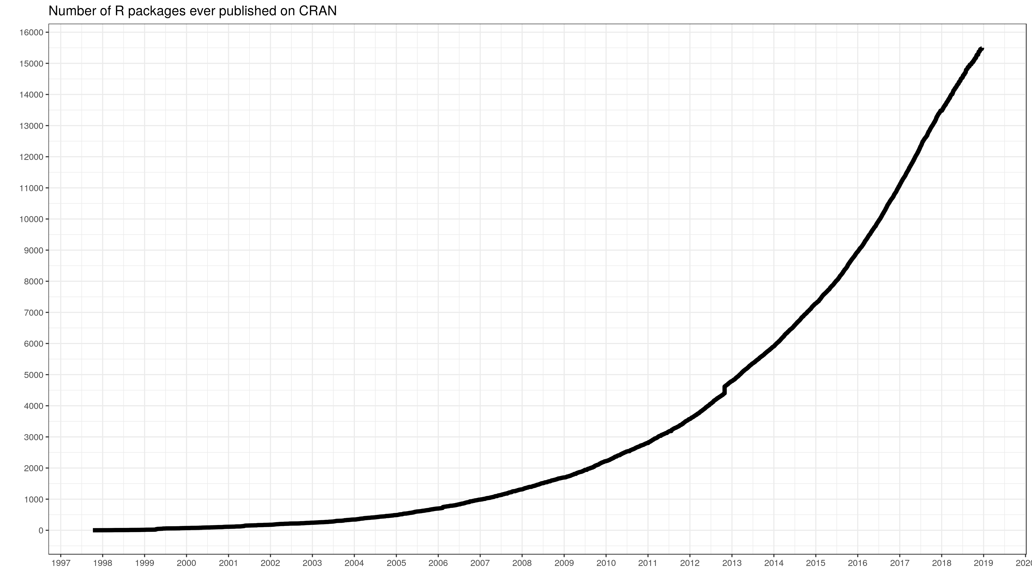
R Pros
Free! Now and always
Incredible documentation and help networks
Stack Overflow, RStudio Community, GitHub, etc.
Widely implemented in research and data science worlds
Possibly the most widely-taught language in American universities now
Your current and future colleagues will know R
13th most popular programming language
Quantity of packages
>15,000 CRAN packages
Variety of packages

Slide 8
Getting Started
Download R from the R Project website
Download RStudio interactive development environment
Technically optional, but you’ll hate using the base IDE
Optional: download Xcode (Mac)
Needed for compiling some R packages

Slide 9
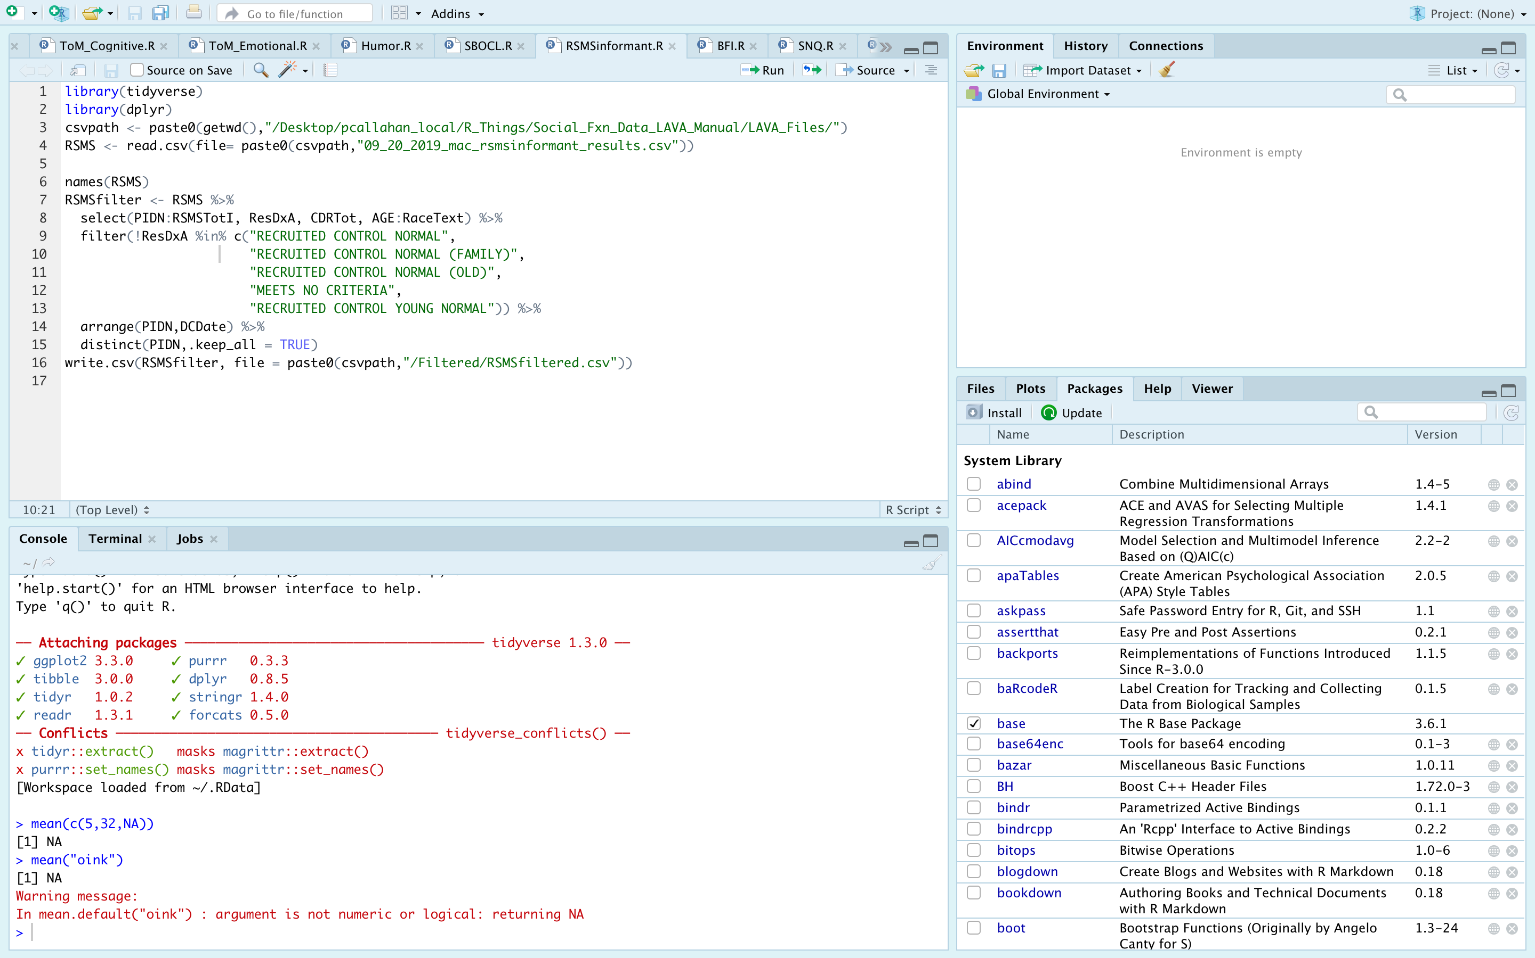

Slide 15
Simple R Syntax
Object assignment:
Use <- or =
Function calls:
Foo(x, …)
Notes:
Start a note line using “#”
Reserved namespaces
TRUE, FALSE, if, NA, NULL, arithmetic operators (+, -, etc.)
Objects starting with “_” or numbers
Case sensitive

Slide 16
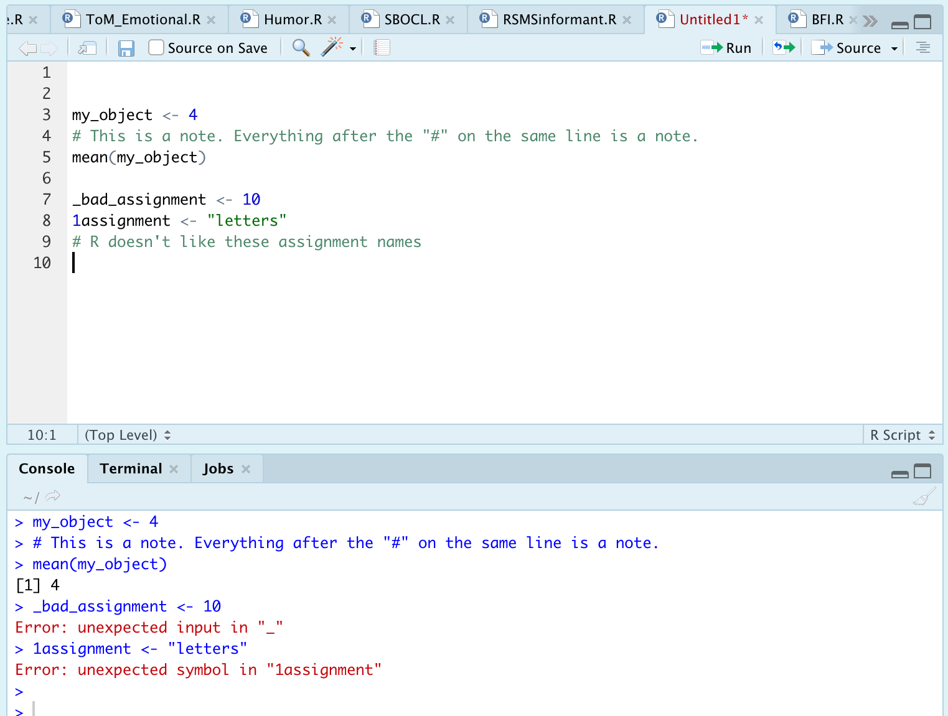
R Syntax: Examples

Slide 17
R Infix Operators
Functions/methods enabling basic expressions
“Infix” refers to the placement of the operator between two variables
What you’ll care about in the beginning:
+, -, *, /, ^,>, <, >=, <=, ==, &, |, =
Complete list at http://applied-r.com/data-infix-operators-in-r/

Slide 18
Booleans
Represent the outcome of a binary evaluation statement
FALSE or TRUE
R also represents booleans as numeric values 0 and 1
This is done under the hood, but means you can perform calculations with boolean values

Slide 19
And/Or
Vectorized evaluations
The & operator is “and”
Each statement to an & statement requires explicit arguments. That is, `data = 4 & 5` is not valid while `data = 4 & data = 5` is
There is a short cut for some instances like this.
The | operator is “or”
Same rules apply as in the “and” statements
&& and || are scalar versions of these statements
Returns only a single TRUE or FALSE statement

Slide 20
And/Or: Example

Slide 21
R Classes
What is a class?
Determination of the data being handled
Essentially determines how functions can/will treat the data
Why does this matter?
Troubleshooting!
What are the classes in R?
Character, factor, numeric (integer or double) logical, etc.

Slide 22
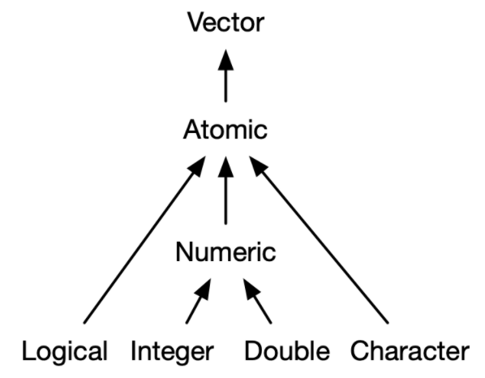
R Classes: Atomic Hierarchy
Notes:
We are scientists, not mathematicians so we don’t need to respect integers.
Factors are NEVER of the atomic type

Slide 23
R Classes: Examples

Slide 24
R Classes: Factors
Similar structure to characters
Can be either numbers or strings
Note that they are NOT of the numeric class—you can set numerics to be factors if desired
Contain ”levels”
Internally-numbered hierarchy that affects output ordering
Default is by alphanumeric order
See factor(), ordered(), and relevel() for help
Notes:
Factors warrant their own discussion because of how important they will be for grouping analyses
Exercise: make a factor out of “easy” “medium” and “hard” to see the ordering results

Slide 25
R Functions
Take an object and a set of arguments
Object is typically a vector or dataframe
Arguments should be named explicitly in the beginning
R accepts positional and partial matching, however
g

Slide 26
R Structures: Vectors

Slide 27
R Structures: Lists
Can be thought of as similar to a vector except objects retain their identities
Objects in a list can be anything: a vector, a single number, multiple data frames
Lists can contain lists!
Powerful feature useful for iterative processes, nested data, and other situations

Slide 28
R Structures: Matrices & Arrays
Matrix: unlabeled N x M data space
Transposable (if ever needed)
Array: stacked matrices into 3D space
Notes:
Again, going to disrespect mathematicians here. I don’t care

Slide 29
R Structures: Data frames
Bread and butteR of data representation
csv, .xlsx, .rdata
Generic term for storing data in a 2D format
Rows = observations, columns = variables
Implemented in a variety of packages and manners
Generic R method, {data.table}, {tibble}

Slide 30
*Tibbles*
Base R data table structure
stringsAsFactors
Printing method (ugly)
Data.table
Fast
Still ugly
Tibbles
Simultaneously data frame, data table, and tibble
Strings
Superior print method
Notes:
I previously mentioned that R has some baggage associated with it
Base data frame sets stringsAsFactors = T (super annoying), prints the whole object
Keep an eye out for the vroom package

Slide 31
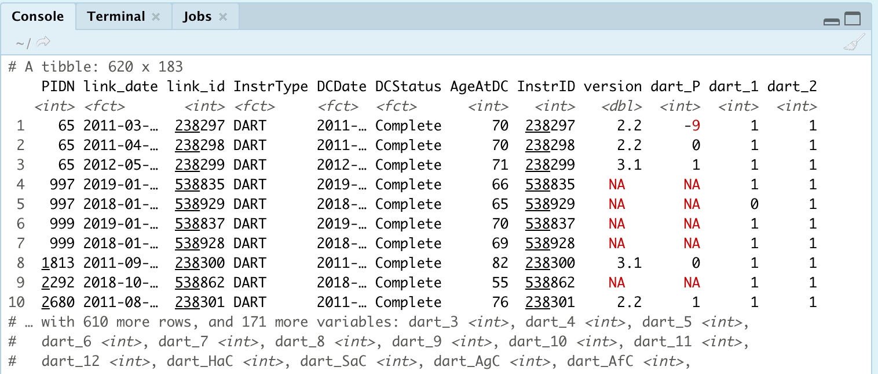
Tibbles: Example

Slide 32
{tidyverse}
Notes:
A tibble is one of the principal components of the tidyverse so this is a good transition point

Slide 33
What is the {tidyverse}?
Collection of packages that are indispensable in the R data science community
{ggplot2}, {readr}, {dplyr}, {tibble}, {stringr}, {purrr}, {lubridate}, {magrittr}, {glue}, {rlang}
Developed by Hadley Wickham and many others of the RStudio Team
Occasionally called the Wickham-verse

Slide 34
Advice: Learn {tidyverse}
Notes:
Structure your learning around this
It is hands-down the most complete and most used ecosystem of packages
You will understand SO and RStudio community questions infinitely better when you see that most questions involve or include fxns from the tidyverse

Slide 35
Starting Packages
{ggplot2}
{readr}
Use read_csv()
{magrittr}
The pipe function, %>%
{dplyr}
5 verbs for data manipulation

Slide 36
{ggplot2}
Notes:
Three main plotting ecosystems tradtionally: base R, lattice, and ggplot2.
Base R is ugly, although improved with 4.0 release
Lattice has fallen by the wayside. It tried to be a mix of base R and ggplot2
Ggplot2 undoubtedly most popular, take my word for it. BBC, 538, and other websites actually build graphs using ggplot2 (with their own custom themes—you can actually download the BBC default themes.) I present no further proof.
Also take a look at plotly and gganimate for interactive and/or animated graphs

Slide 37
Starting Packages
{ggplot2}
{readr}
Use read_csv()
{magrittr}
The pipe function, %>%
{dplyr}
5 verbs for data manipulation

Slide 38
{readr}

Slide 39
Starting Packages
{ggplot2}
{readr}
Use read_csv()
{magrittr}
The pipe function, %>%
{dplyr}
5 verbs for data manipulation

Slide 40
{magrittr}

Slide 41
Starting Packages
{ggplot2}
{readr}
Use read_csv()
{magrittr}
The pipe function, %>%
{dplyr}
5 verbs for data manipulation

Slide 42
Notes on {dplyr}
Developed as a coherent ecosystem for data manipulation
Improved syntax over base R data cleaning operations
Familiar to SQL users
Start with learning this package when it comes to data cleaning
Notes:
Familiar to SQL users—in fact, the functions we’re about to see are exact counterparts, and they generate SQL code under the hood so you can interact directly with a SQL database if that’s a need. Great if, for example, working with high dimensional data from an EMR or other database

Slide 43
{dplyr}: select()

Slide 44
{dplyr}: filter()

Slide 45
{dplyr}: arrange()

Slide 46
{dplyr}: mutate()

Slide 47
{dplyr}: summarise()

Slide 48
Starting Packages
{ggplot2}
{readr}
Use read_csv()
{magrittr}
The pipe function, %>%
{dplyr}
5 verbs for data manipulation

Slide 49
Other Packages to Consider
{apaTables}
{broom}
{devtools}
{usethis}
{purrr}

Slide 50
Discovering Data and Troubleshooting

Slide 51
Exploration Tools
Look at your table in Excel or using View()
Quantitative information
str()
summary()

Slide 52
Help! (I need somebody!)
?foo or help(foo)
?foo or help(foo)
?foo or help(foo)

Slide 53
Help! Other Options
Vignette()
Google
Stack Overflow + RStudio Commuity
GitHub (tread lightly)

Slide 54
Troubleshooting: Clearing Environment
Package conflicts/masks
Too many objects in the environment to keep track of
Useful cleaning functions
rm( list=ls() )
.rs.restartR()

